Slide 1

TRADER, SUPPLIER & MANUFACTURE
Pre-Engineered Building
Light Gauge Framing System
Colour Coated Sheet
Insulated Puf Panel
FRP & Polycarbonate Sheet
All industrial building accessories etc…
Services: - Erection, Installation & Maintenance
Office Address : 204 Aggarwal Prestige Mall, Pitampura, New Delhi-110034
Registered Office : E-Block , House No. 35, Street No. 3, Mukund Vihar,
Karawal Nagar, Delhi-110094

Slide 2
ABOUT GROUP
M/s ARTIFEX INFRA co company of R. K. ENTERPRISES. ARTIFEX INFRA was formerly known as R. K. Enterprises, its establishment was in 2002, and till 2016.
ARTIFEX INFRA has corporate office at New Delhi having Outsourced Production facilities in Bahadurgarh (Cold Farm lines & Accessories lines) and Faridabad (Built up lines) which have 45,000MT per Annam.
We are a professionally managed company and we are dedicated for our all customers. PEB’s are tailor made buildings virtually leakage proof & designed on specific software’s like MBS/AutoCAD/ Stadd Pro- PEB’s are customized as per the requirements and easily expandable.

Slide 3
PEB V/S CONVENTIONAL
 | PRE-ENGINEERED BUILDINGS | CONVENTIONAL STEEL BUILDINGS
Structure Weight | Pre Engineered Buildings are on the average 30% lighter through the efficient use of steel. | Primary steel members are selected from standard hot rolled “I” Sections, which are, in man segments of the members heavier than what is actually required by design.
Design | Quick and efficient: since PEBs are mainly formed of standard sections and connections, design time is significantly reduced. | Each conventional steel structure is designed from scratch by the consultant, with fewer design aids available to the Engineer.
Delivery | Average 6 to 8 weeks. | Average 20 to 26 weeks.
Erection Cost and Time | Both costs and time of erection are accurately known based upon extensive experience with similar buildings. | Typically, conventional steel buildings are 20% more expensive than PEB. In most of the cases, the erection costs and time are not estimated accurately.
Seismic Resistance | The low-weight flexible frames offer higher resistance to seismic forces. | Rigid heavy weight structures do not perform well in seismic zones.
Future Expansion | All project records are safely and orderly kept in electronic format indefinitely making it easy for the owner or designer to obtain a copy of his building records at any time. So, Easy & Cost Effective. | It would be difficult to obtain project records after a long period of time. It is required to contact more than one party. Involved in the project, to obtain accurate information. So, Difficult & costlier.
Overall Price | Price per square meter may be as much as 30% lower than conventional steel. | Higher price per square meter.

Slide 4
ADVANTAGES & APPLICATIONS
PEB Advantage
Architectural Versatility
Flexibility in expansion
Low Maintenance
Energy Efficiency
Consistent Superior Quality
Reduction in Project cost
Savings in Construction Time
Suitable for varied projects
Seismic Resistant
Turnkey Solutions
Application of PEB:-
  Warehouse,
  Factories,
  Workshops / Showrooms,
  Hangers,
  Cold Stores
  Heavy Structure Steel
  Railway stations
  Airport Buildings

Slide 5
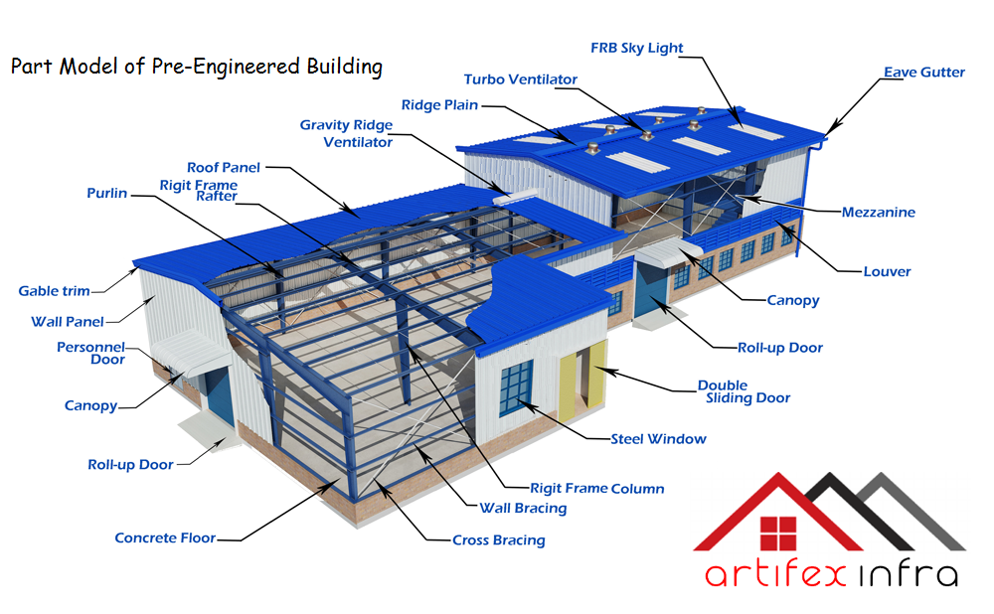
PRE-ENGINEERED BUILDINGS

Slide 6

DESIGN
ARTIFEX INFRA DESIGN YOUR BUILDING TO FULFILL YOUR REQUIRMENT WITH OPTIMIZATION
“ARTIFEX INFRA” Design & Engineering Team design your building with high efficiency and accuracy to fulfill your need & action plan for your building.
All buildings are designed & erected as per the American Standards & Indian Standards (IS) Codes of practice.
APPLICABLE DESIGN CODES
MBMA (Metal Building Manufacturing Association)
In Accordance with 2002 edition of low rise building solution.
Wind load IS-875(Part-III)-1987
Earthquake load IS-1893 (Part-I)-2002
Hot rolled and built-up manual of Steel construction, 9th edition of AISC.
Cold Form 1996 edition of AISI.
Welding- Structural Steel Welding Code of American Welding Society (QWS.D1.98
BIS (Bureau of Indian Standard)
Design Dead Load IS-875 (Part-I)-1987
Design Imposed Load IS-875 (Part-II)-1987
Design Wind Load IS-875 (Part-III)-1987
Earthquake resistance IS-1983 (Part-I)-2002
Design of Hot Rolled built-up IS-800 (1984 & 2007)
Tapered built-up 9th edition of AISC.
Cold Form IS-801 (1975)
Welding- (AWS d1.1.98), IS-816 (1969)
ARTIFEX INFRA use modern design software like:
Stadd Pro, Auto CAD, MBS, 3DS MAX

Slide 7
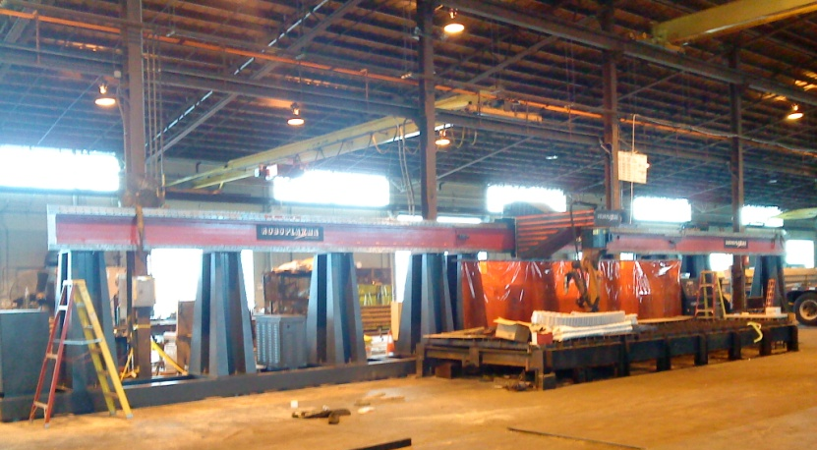
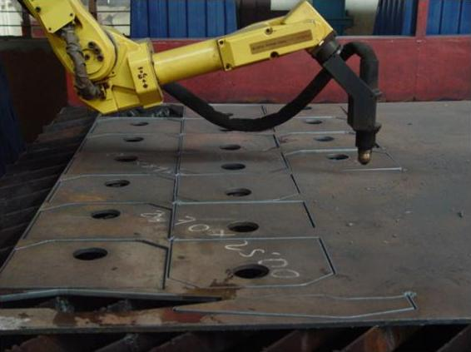
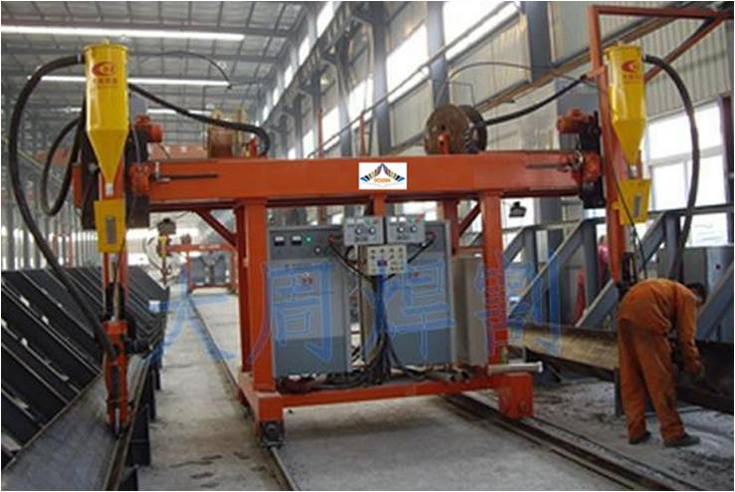
MANUFACTURING
ARTIFEX INFRA today, has a production capacity of more than 45,000 MT per annum of steel built Up Sections, roofing & cladding systems and Cold Form Sections between its 2 outsourced facilities located Bahadurgarh(2006) for roofing & cladding systems and cold form sections with al accessories. and Faridabad(2012) lines for Built up sections and other related accessories.
Artifex infra have in-house installed special equipments to procedure quality such as:
Fully automated Robotic plasma cutting machine.
Automatic continuous submerged are welding machines.
H Beam Assembly Line
H Beam SAW Welding Line
H Beam Straightening Line
Cold Form Line
C Purlin
Z Purlin
Roofing and wall cladding machine
Punching and Drilling machines.
Guard Rail Profile Machine
Metal Decking
MIG Welding Machines.
ARC Welding Machines.
Overhead Crane (3nos of Ton Capacity)
Power Press
Hydraulic Press
Threading Machines
Drill Machines
Press Break
Bending and shearing machine.

Slide 8
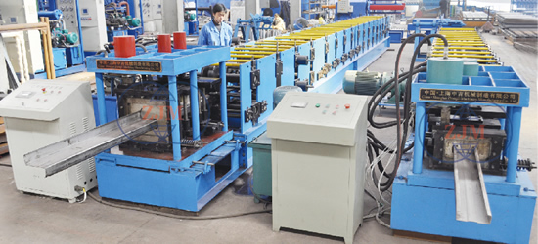
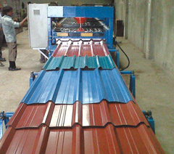
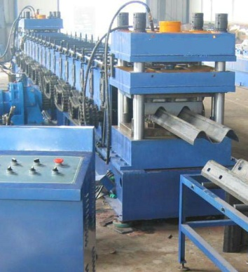
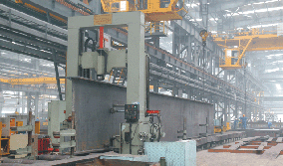

Slide 9
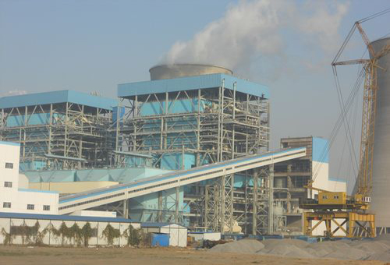
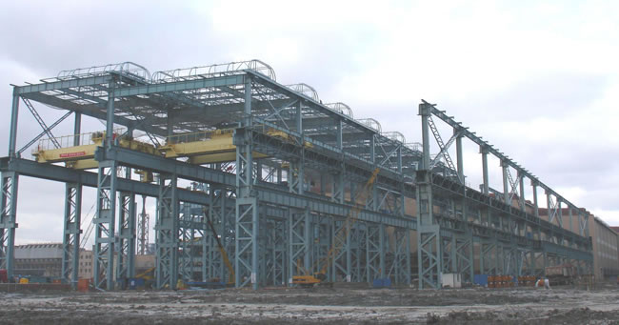
PRE-FABRICATED HEAVY STRUCTURE STEEL
Artifex Infra is an leading company in the area of Design, Fabrication and Erection of heavy
structural steel works for Power Plants, Coal Bunkers, Airport Hangers, Station buildings & Switchyards Cement and steel plant
Manufacturing facility for Heavy Steel Structure :
H- Beam Welding Line, H-Beam Assembly Line and H-Beam Straightening Line
H-Beam Welding Line, Straightening line & Assembly Line
Beam Width - 2000mm
Depth - 500mm
Web Thickness - 25mm
Flange Thickness. - 40mm
Tapered - 8°
Length - 15M
Welding speed – 2.5M/min

Slide 10
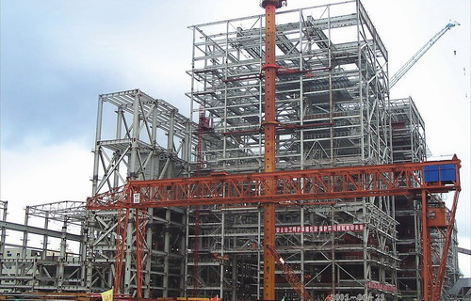
H-BEAM LINE FABRICATION
Plasma/Sheer Cutting of Flange & Web
Assembly Line Tuck Welding & Centering
Saw Welding Line
Straightening
Web & Flange of H Beam
Saw Welding Line
Shot Blasting (if required)
Primer
Final paint at site & Ready for Erection
Final H Beam

Slide 11
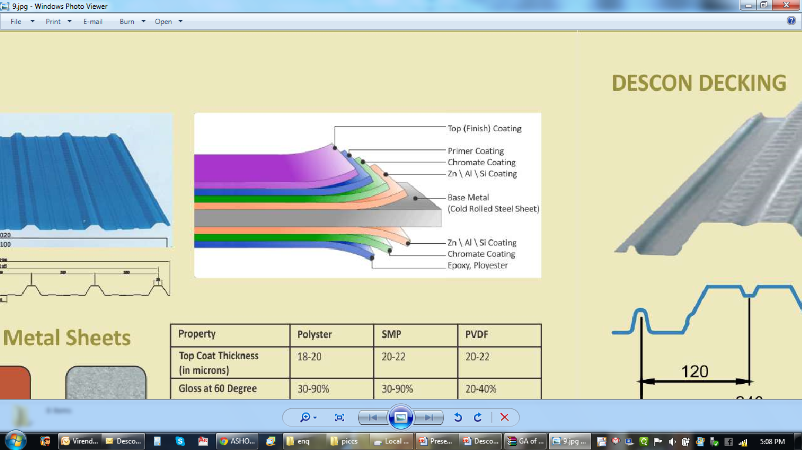
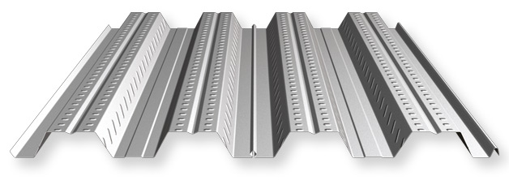
METAL ROOFING & WALL CLADDING

Slide 12
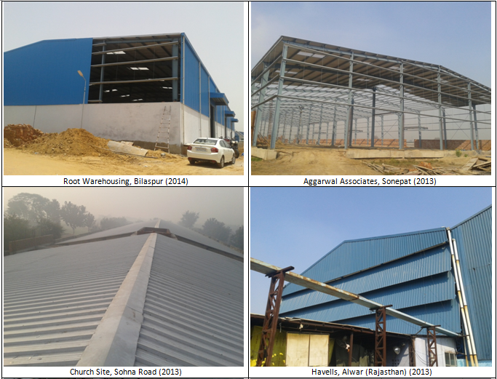
ON GOING & COMPLETED PROJECTS

Slide 13
THANKING YOU
From :
ARTIFEX INFRA
Office Address : 204 Aggarwal Prestige Mall, Pitampura, New Delhi-110034
Registered Office : E-Block , House No. 35, Street No. 3, Mukund Vihar,
Karawal Nagar, Delhi-110094

